Slide 1
Unit 5

Slide 2

Advance organizer
Learning objectives:
Understand 13.1 Exploring Periodic Data
Prior knowledge:
Understand 7.6 Natural Logarithm
Successful criteria:
Controlled Practice: Complete the Exit Card
Freer Practice: Complete questions to your interest
Learning activities:
1. Preview and Vocabulary Check (10 minutes):
Quickly scan through the text and noting any unfamiliar terms.
2. Comprehend the Presentation (45 minutes):
3. Exit Card Completion (25 minutes):
4. Main Idea Summary and Reflection (5 minute):

Slide 3
Key terms:
Periodic function [周期函数]: A function that repeats its values in regular intervals or cycles.
Cycle [周期]: A single complete execution of a periodic phenomenon.
Period [周期]: The length of one cycle of a periodic function.
Amplitude [振幅]: The maximum absolute value of a periodic function, measured from the midline.
Midline [中轴线]: The horizontal line that represents the average value of a periodic function.

Slide 4
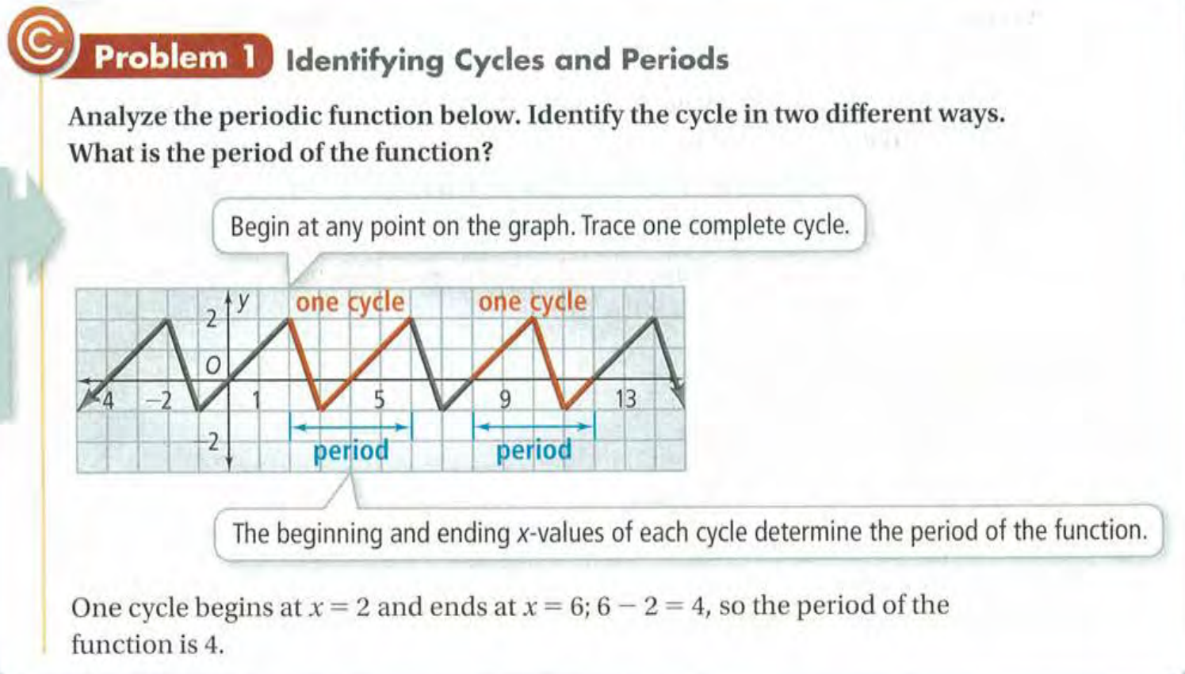

Slide 5
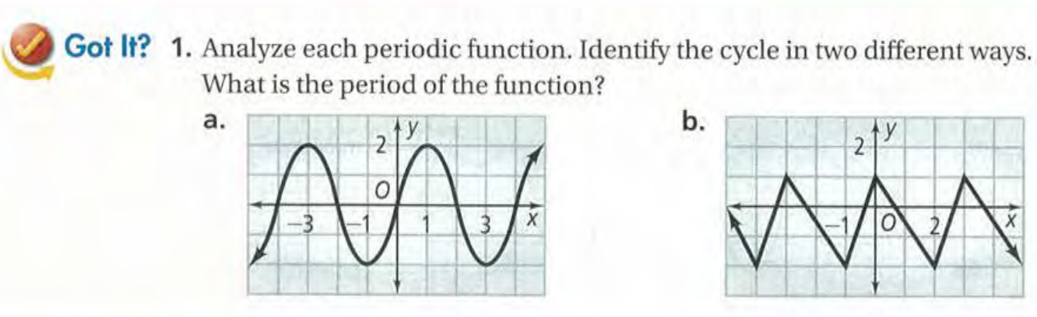

Slide 6
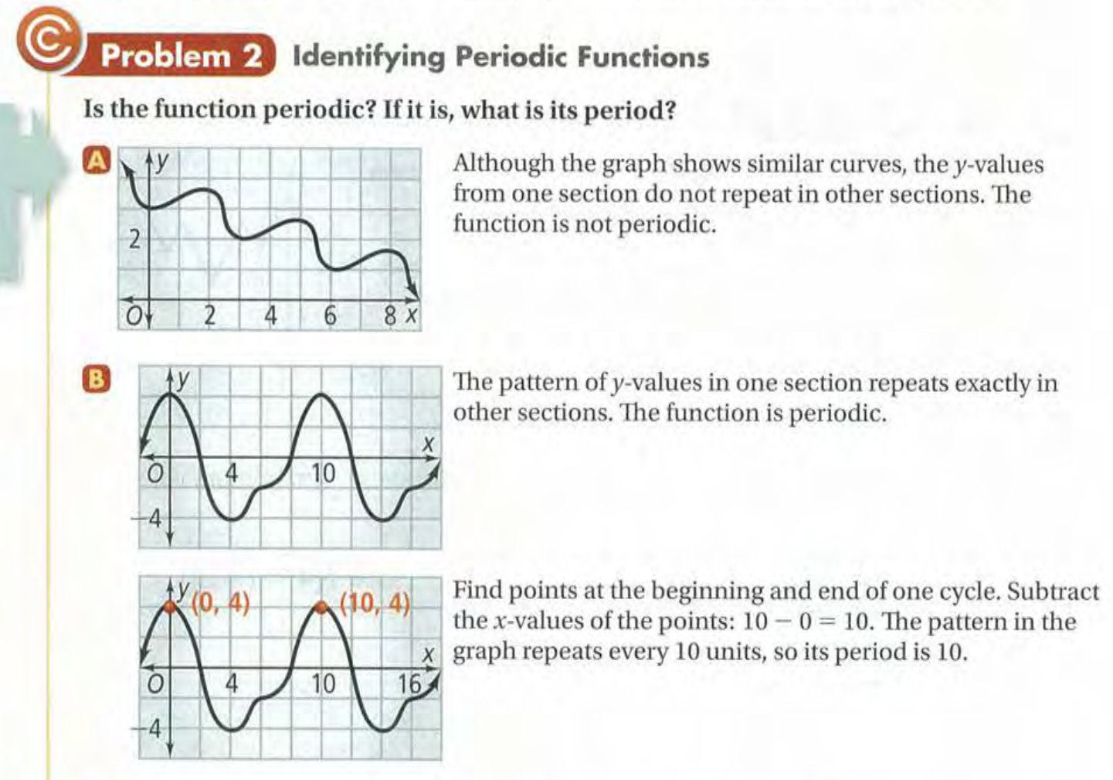

Slide 7
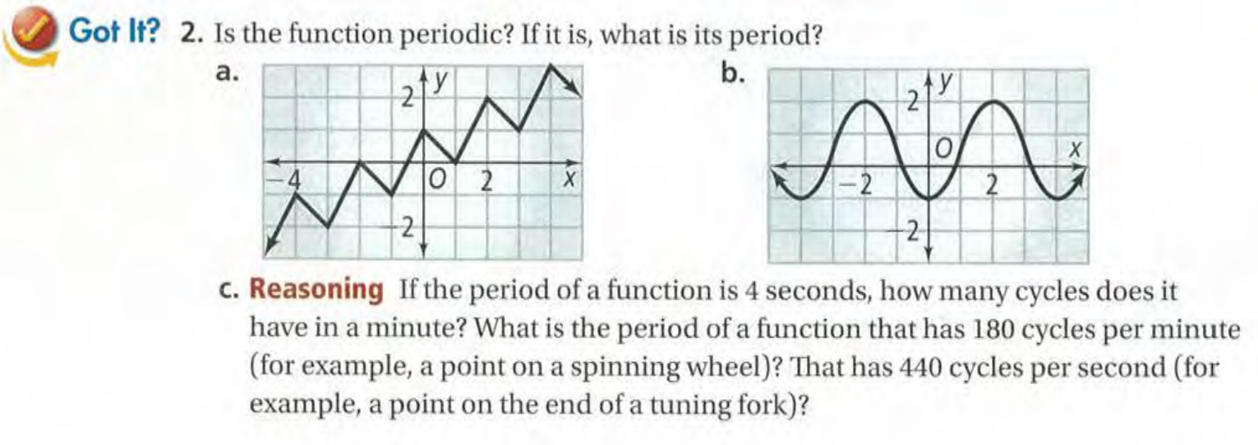

Slide 8
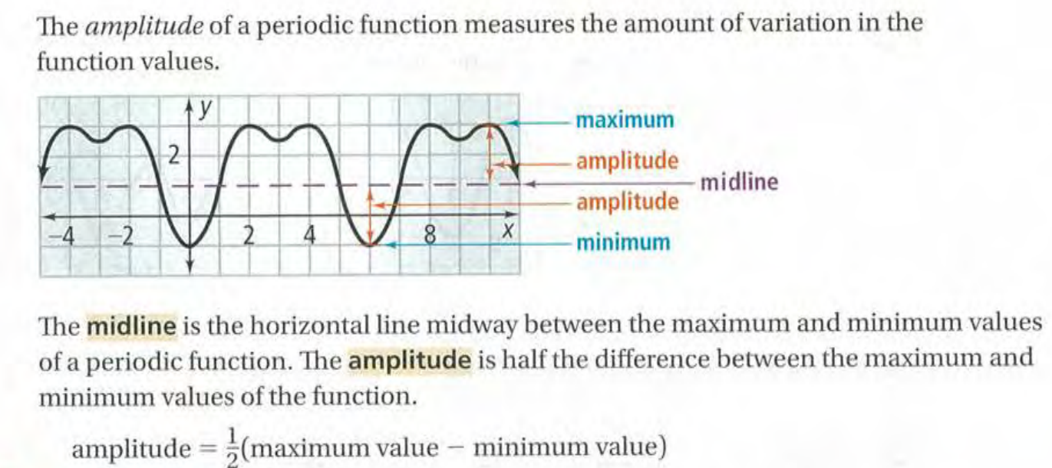

Slide 9
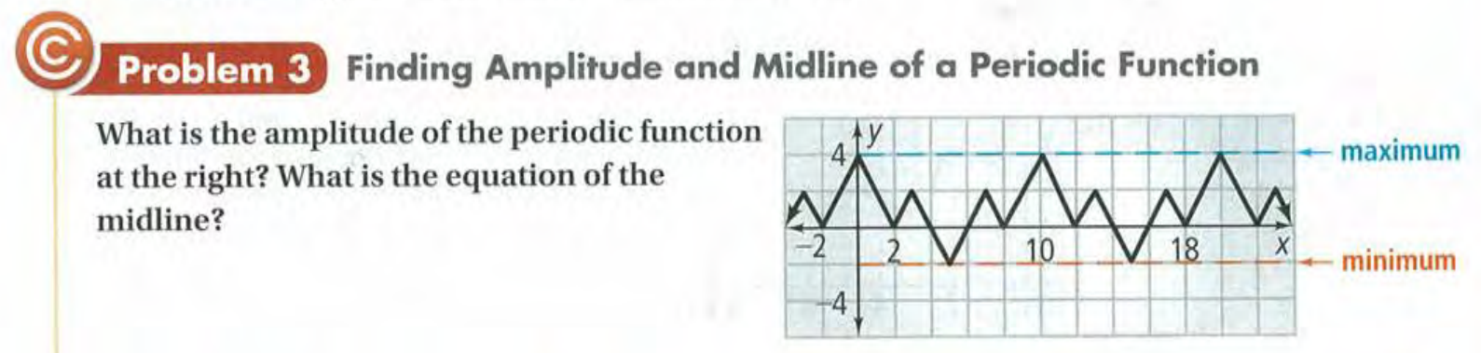

Slide 10
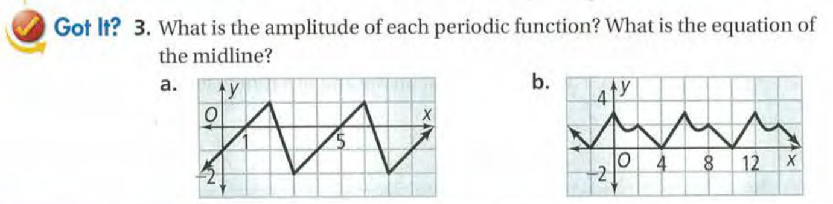

Slide 11
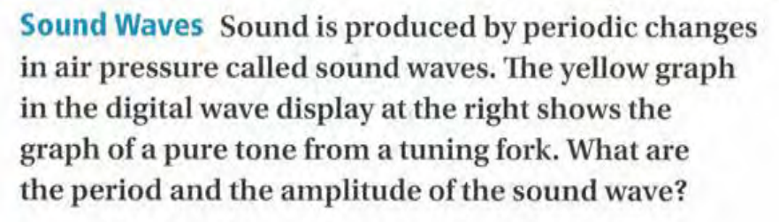
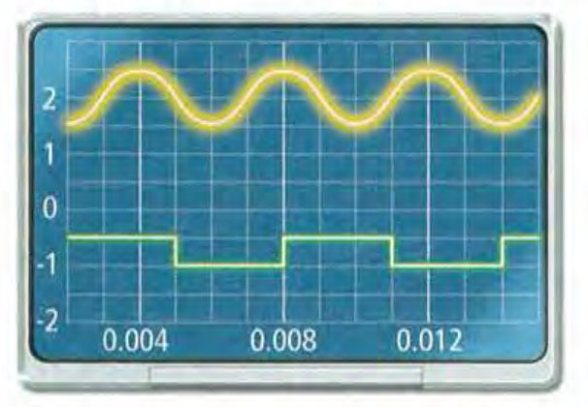

Slide 12
Exit Card:
Complete the “Exploring Periodic Data” learning sheet!

Slide 13
Advance organizer
Learning objectives:
Understand 13.2 Angles and the Unit Circle
Prior knowledge:
Understand 13.1 Exploring Periodic Data
Successful criteria:
Controlled Practice: Complete the Exit Card
Freer Practice: Complete questions to your interest
Learning activities:
1. Preview and Vocabulary Check (10 minutes):
Quickly scan through the text and noting any unfamiliar terms.
2. Comprehend the Presentation (45 minutes):
3. Exit Card Completion (25 minutes):
4. Main Idea Summary and Reflection (5 minute):

Slide 14
Key terms:
Standard position [标准位置]: The position of an angle in the coordinate plane where the vertex is at the origin and the initial side is along the positive x-axis.
Initial side [初始边]: The starting position of an angle in standard position, which is along the positive x-axis.
Terminal side [终边]: The position of the rotating arm of an angle in standard position after rotation, which determines the measure of the angle.
Coterminal angles [同角]: Angles that have the same initial and terminal sides, differing by an integer multiple of 360 degrees or 2π radians.
Unit circle [单位圆]: A circle with a radius of 1 centered at the origin in the coordinate plane, used to define trigonometric functions.

Slide 15
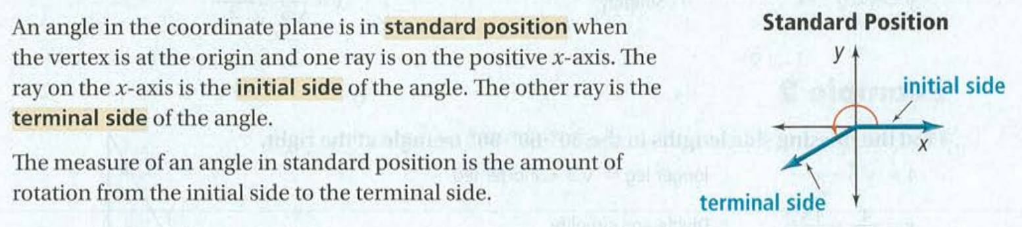
Angle measurement

Slide 16
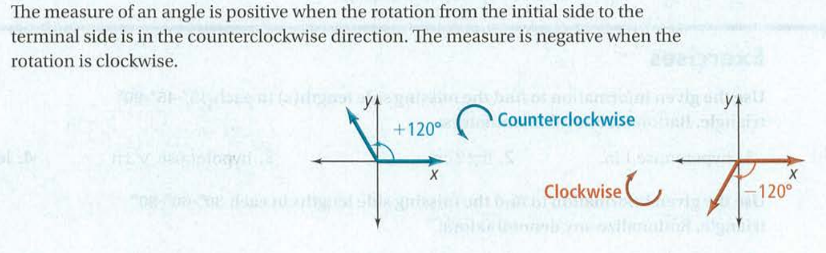
Positive and Negative angles

Slide 17
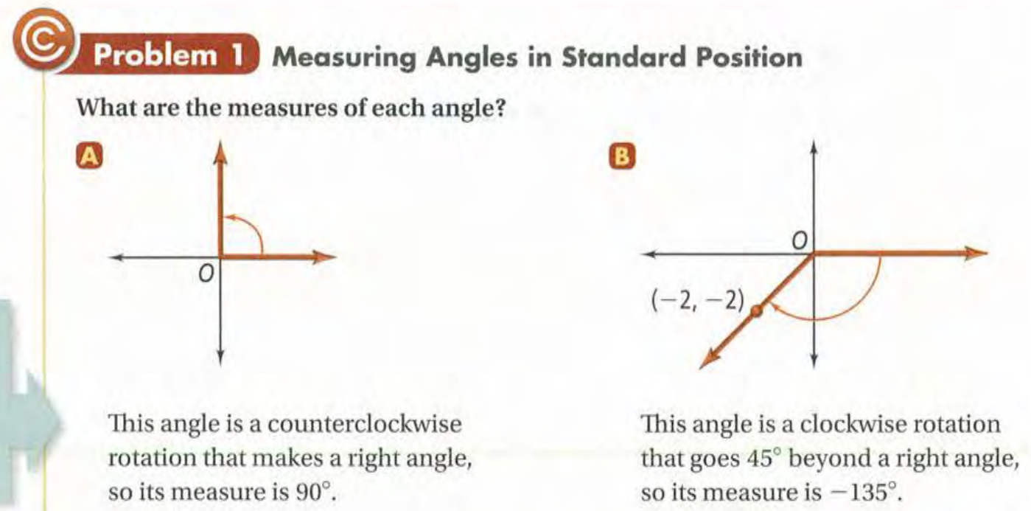

Slide 18
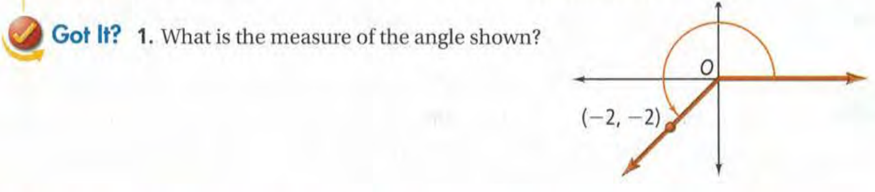

Slide 19
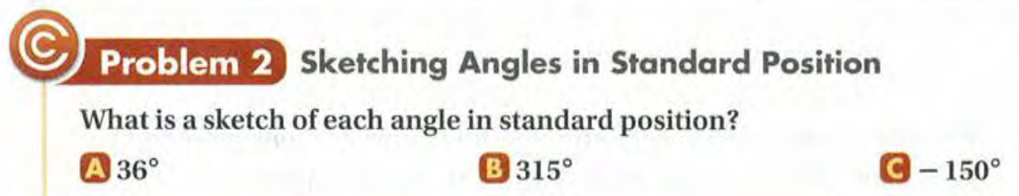
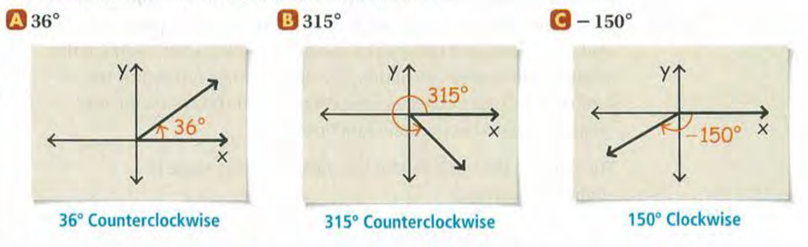

Slide 20
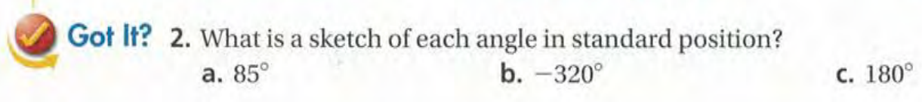

Slide 21
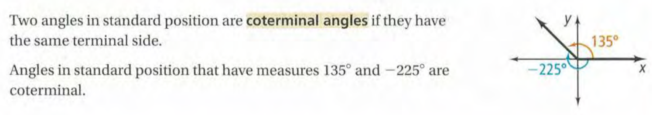
Coterminal angles

Slide 22
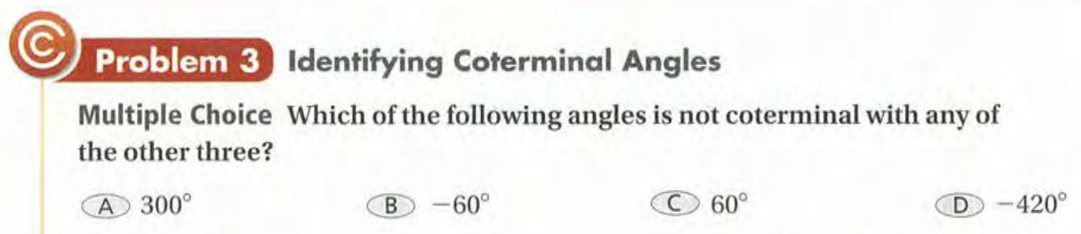
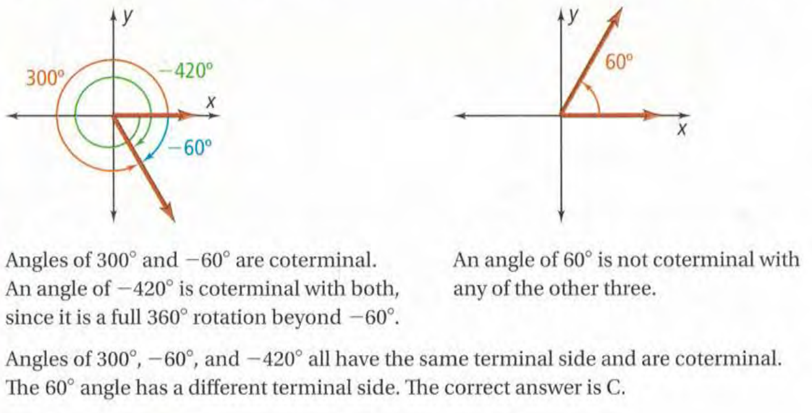

Slide 23
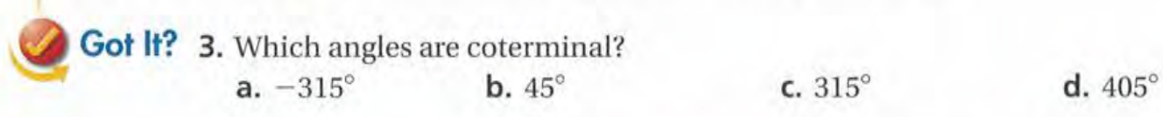

Slide 24
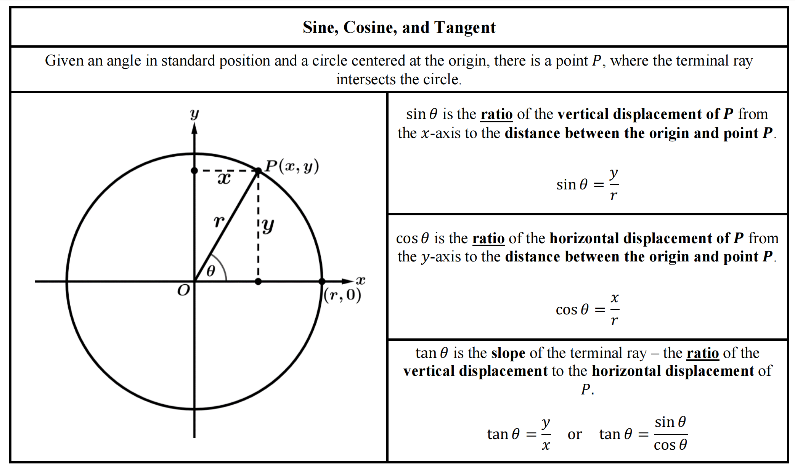

Slide 25
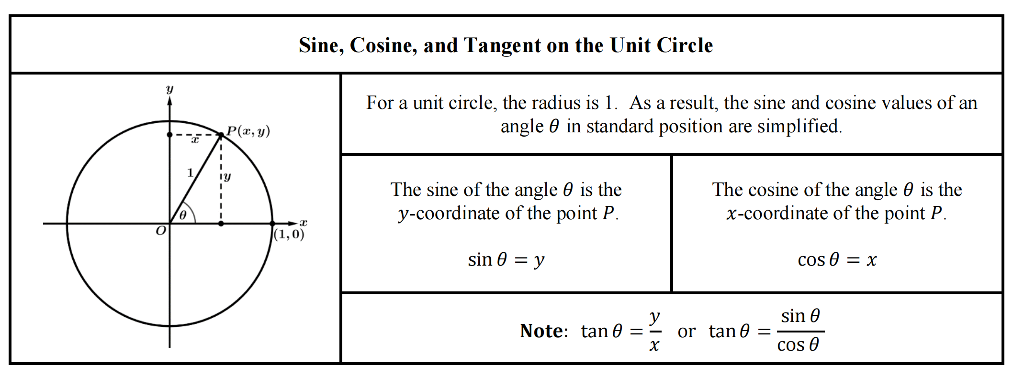

Slide 26
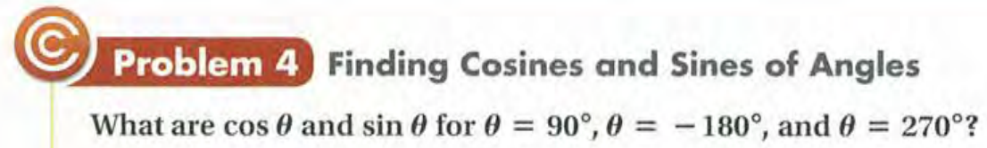
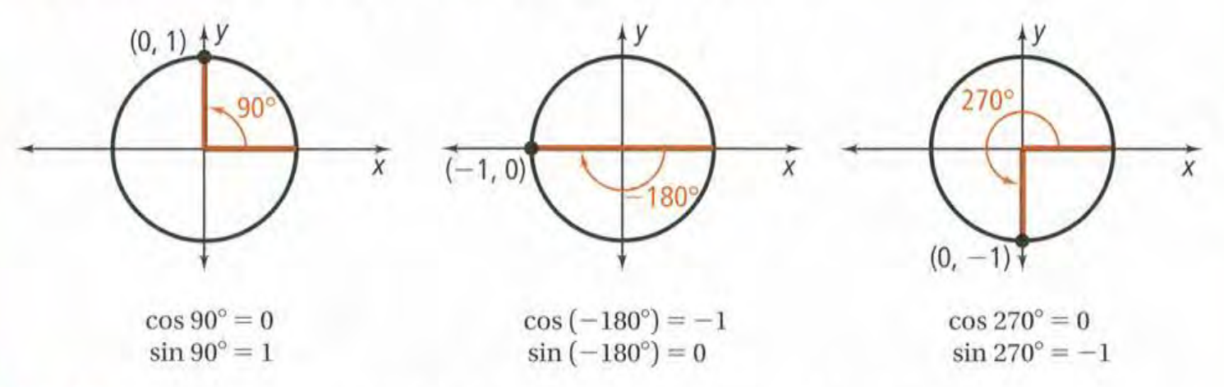

Slide 27
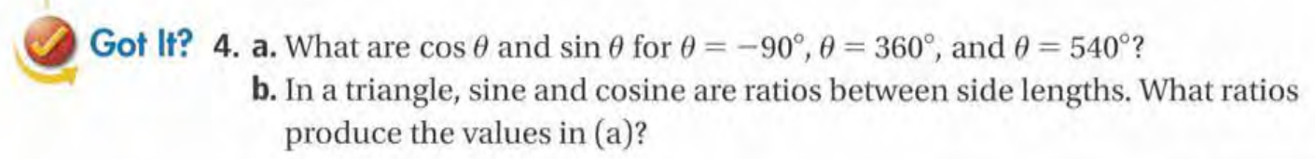

Slide 28
Exit Card:
Complete the angles and the unit circle learning sheet!

Slide 29
Advance organizer
Learning objectives:
Understand 13.2 Angles and the Unit Circle II
Prior knowledge:
Understand 13.1 Exploring Periodic Data
Successful criteria:
Controlled Practice: Complete the Exit Card
Freer Practice: Complete questions to your interest
Learning activities:
1. Preview and Vocabulary Check (10 minutes):
2. Comprehend the Presentation (45 minutes):
3. Exit Card Completion (25 minutes):
4. Main Idea Summary and Reflection (5 minute):

Slide 30
Key terms:
Reference angle [参考角]: In trigonometry, the reference angle is the positive acute angle between the terminal side of an angle in standard position and the x-axis.

Slide 31
Reference angle: Associated acute angle

Slide 33
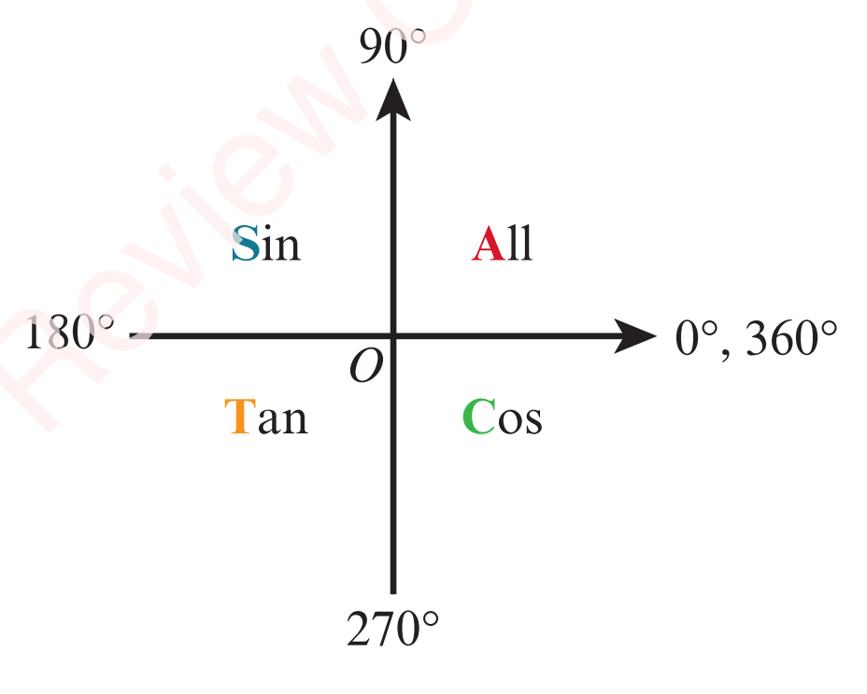
CAST Rule

Slide 34
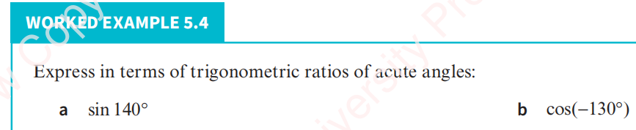
Use reference (basic acute) angle to find trigonomatric ratios

Slide 35
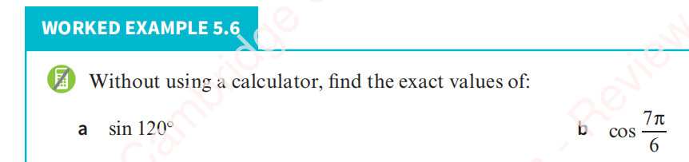

Slide 36
Exit Card:
Complete the “Angles_and_Unit_Circle” learning sheet!

Slide 37
Advance organizer
Learning objectives:
Understand 13.3 Radian Measure
Prior knowledge:
Understand 13.2 Angles and the Unit Circle II
Successful criteria:
Controlled Practice: Complete the Exit Card
Freer Practice: Complete questions to your interest
Learning activities:
1. Preview and Vocabulary Check (10 minutes):
2. Comprehend the Presentation (45 minutes):
3. Exit Card Completion (25 minutes):
4. Main Idea Summary and Reflection (5 minute):

Slide 38
Key terms:
Central Angle [中心角]: The angle formed by two radii of a circle that are drawn to the endpoints of an arc, measured in degrees or radians.
Intercepted Arc [弧长]: The length of the arc between two points on a circle, often determined by the central angle subtended by the arc.
Radian [弧度]: A unit of angular measurement used in mathematics and physics, equal to the angle subtended at the center of a circle by an arc equal in length to the radius.
Sector [扇形]: A region bounded by two radii of a circle and the arc between them.

Slide 39
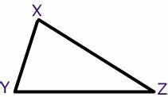
Group discussion
If the angles of a triangle can add up to less than 180°, 180° or more than 180°, what does this tell us about the nature of mathemcatical knowledge?
Moscow
Sydney
Johannesburg

Slide 40
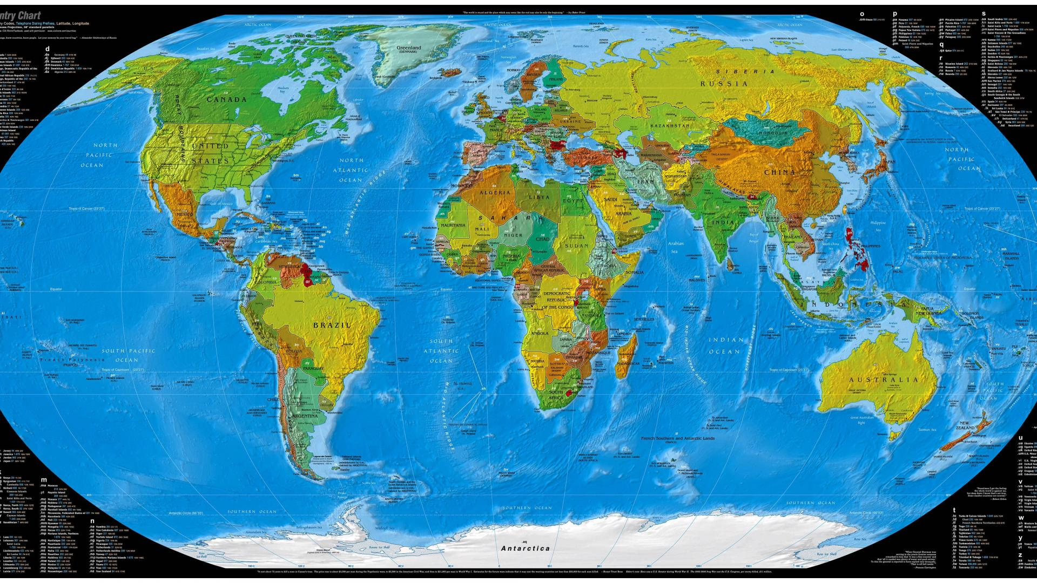
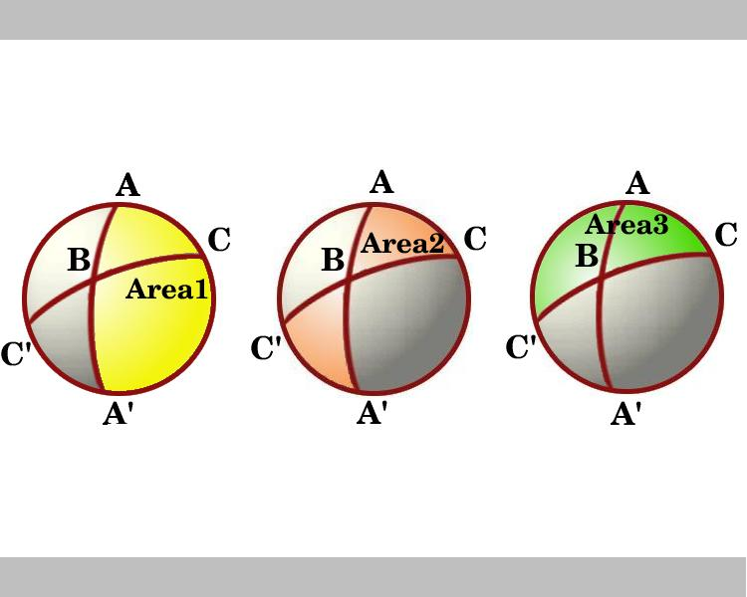
TOK moment

Slide 41
Degree measure
In Geometry
< 90° = Acute Angle
90° = Right Angle
> 90° and < 180° = Obtuse Angle
180° = Straight Angle
> 180° and < 360° = Reflex Angle
360° = Complete Angle

Slide 42
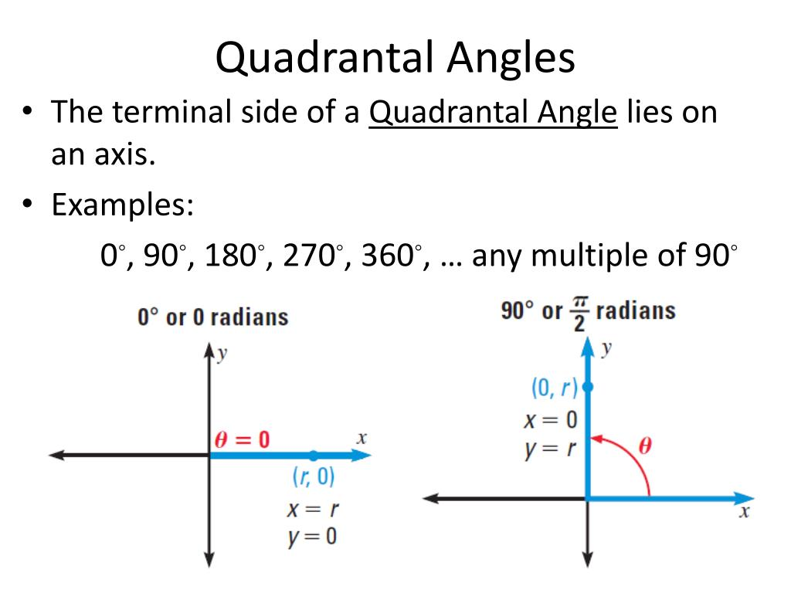

Slide 43
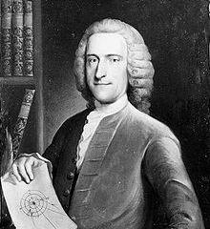
Radian measure
The concept of radian measure, as opposed to the degree of an angle, is normally credited to Roger Cotes in 1714. He described the radian in everything but name, and he recognized its naturalness as a unit of angular measure. Prior to the term radian becoming widespread, the unit was commonly called circular measure of an angle.

Slide 44
Radian measure

Slide 45
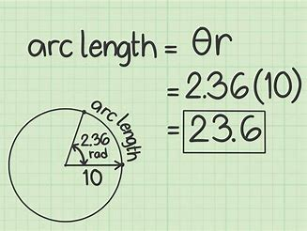
Arc length
S = rθ (where θ is in radian measure)

Slide 46
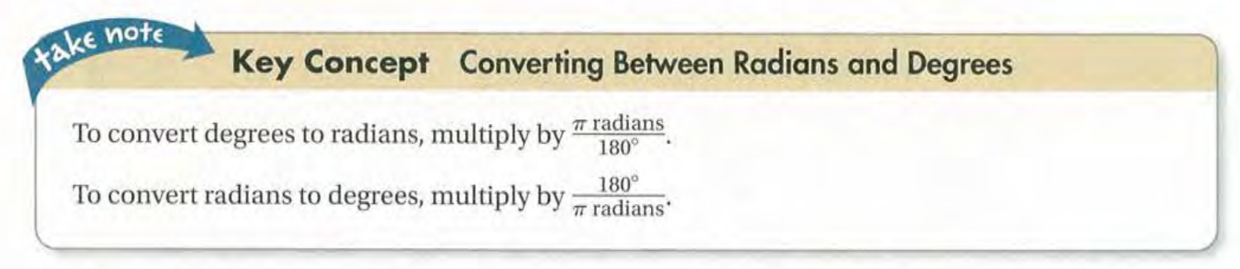

Slide 47
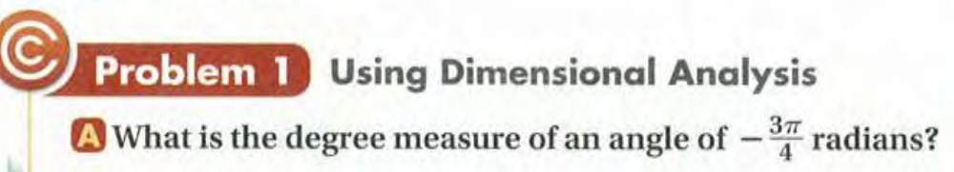

Slide 48
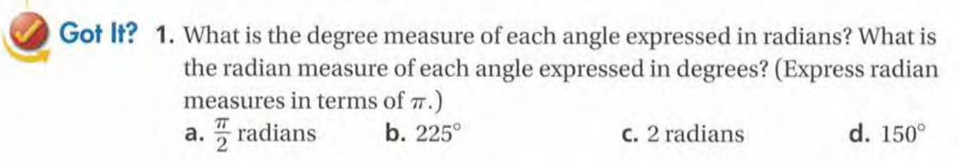

Slide 49
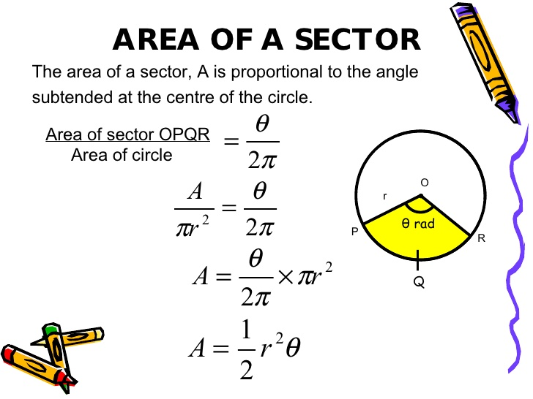

Slide 51
Exit Card:
Complete “radian measure” learning sheet!

Slide 52
Advance organizer
Learning objectives:
Understand 13.4 The Sine Function
Prior knowledge:
Understand 13.3 Radian Measure
Successful criteria:
Controlled Practice: Complete the Exit Card
Freer Practice: Complete questions to your interest
Learning activities:
1. Preview and Vocabulary Check (10 minutes):
2. Comprehend the Presentation (45 minutes):
3. Exit Card Completion (25 minutes):
4. Main Idea Summary and Reflection (5 minute):

Slide 53
Key terms:
Sine Function [正弦函数]: A trigonometric function that describes the relationship between the angles and the lengths of the sides of a right triangle. In a unit circle, it is the y-coordinate of a point on the unit circle corresponding to an angle.
Sine Curve [正弦曲线]: The graph of the sine function, which is a smooth, periodic curve that oscillates between -1 and 1. It represents the periodic nature of the sine function.

Slide 55
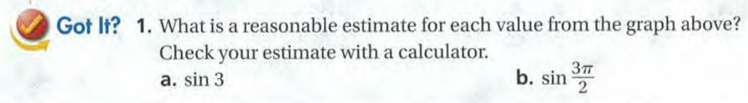

Slide 57
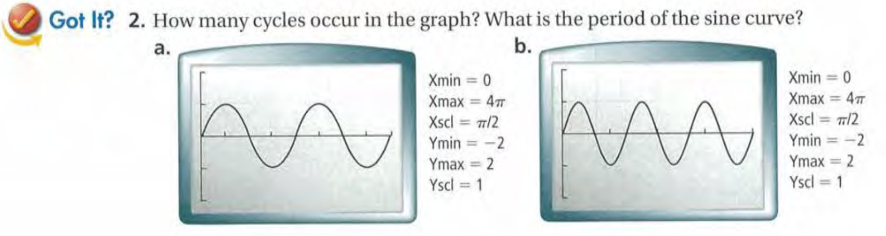

Slide 59
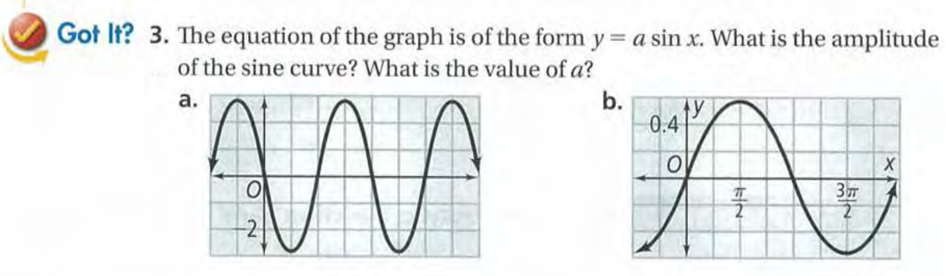

Slide 60
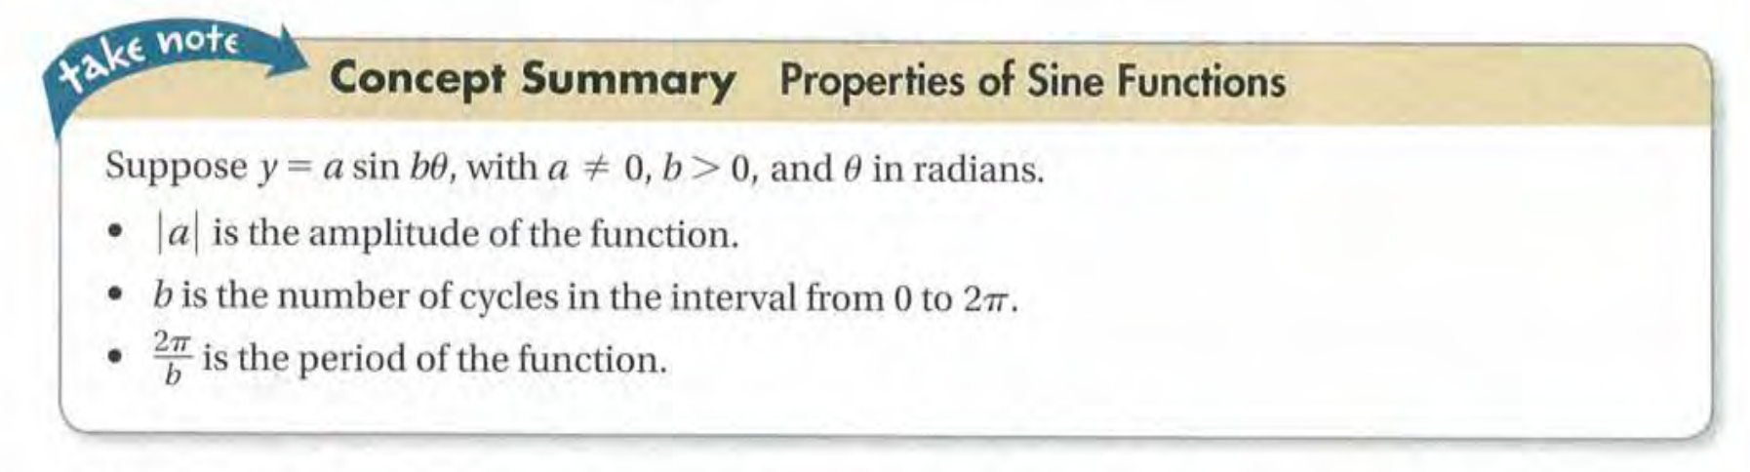

Slide 61
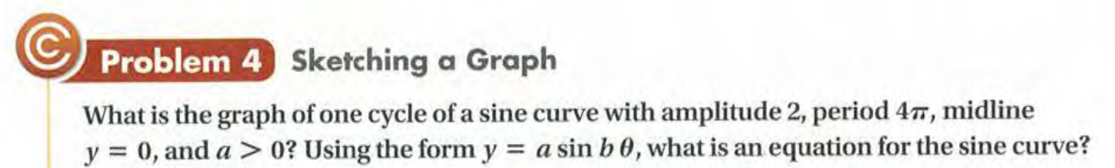
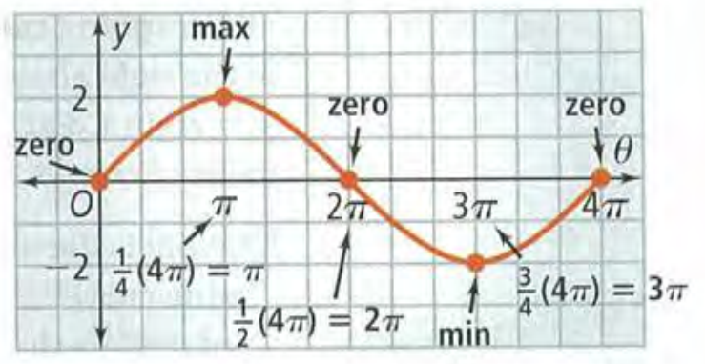

Slide 62
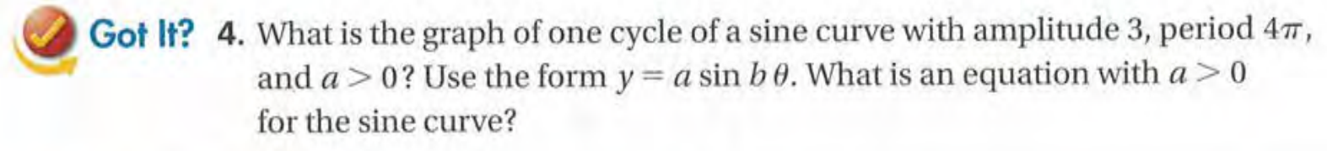

Slide 63
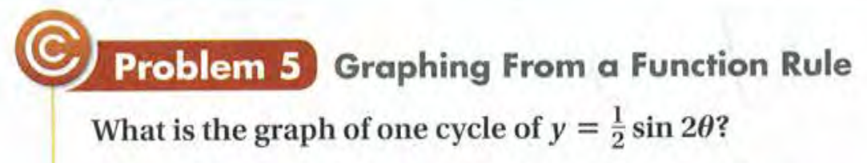

Slide 64
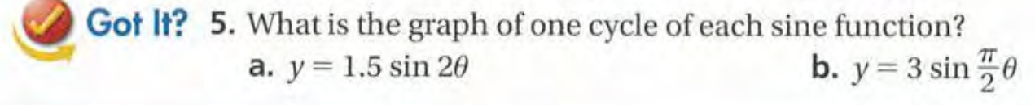

Slide 65
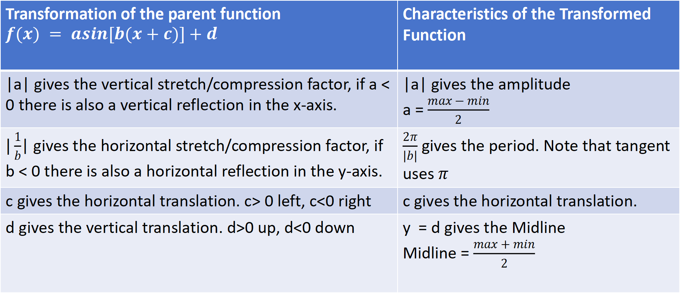
Transformation of the Sine Function
Transformation of the parent function $$f(x) = asin[b(x+c)]+d$$ | Characteristics of the Transformed Function
|a| gives the vertical stretch/compression factor, if a < 0 there is also a vertical reflection in the x-axis. | |a| gives the amplitude a = $\frac{max − min}{2}$
$|\frac{1}{b}$| gives the horizontal stretch/compression factor, if b < 0 there is also a horizontal reflection in the y-axis. | $\frac{2π}{|b|}$ gives the period. Note that tangent uses $π$
c gives the horizontal translation. c> 0 left, c<0 right | c gives the horizontal translation.
d gives the vertical translation. d>0 up, d<0 down | y = d gives the Midline Midline = $\frac{max + min}{2}$

Slide 66
Exit Card:
Complete the sine function learning sheet!

Slide 67
Advance organizer
Learning objectives:
Understand 13.5 The Cosine Function
Prior knowledge:
Understand 13.4 The Sine Function
Successful criteria:
Controlled Practice: Complete the Exit Card
Freer Practice: Complete questions to your interest
Learning activities:
1. Preview and Vocabulary Check (10 minutes):
2. Comprehend the Presentation (45 minutes):
3. Exit Card Completion (25 minutes):
4. Main Idea Summary and Reflection (5 minute):

Slide 68
Key terms:
Cosine Function [余弦函数]: A trigonometric function that is equal to the ratio of the side adjacent to an acute angle (in a right-angled triangle) to the hypotenuse.
Cosine Curve [余弦曲线]: The graph of the cosine function, which oscillates between -1 and 1 with a period of 2π.

Slide 70
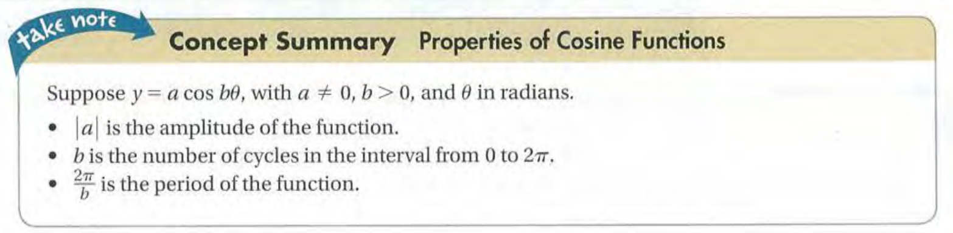

Slide 71
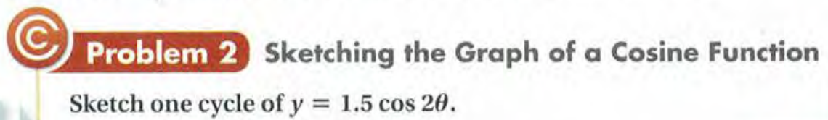

Slide 72


Slide 73
Exit Card:
Complete the cosine function learning sheet!

Slide 74
Advance organizer
Learning objectives:
Understand 13.6 The Tangent Function and Reciprocal Trigonometric Functions
Prior knowledge:
Understand 13.5 The Cosine Function
Successful criteria:
Controlled Practice: Complete the Exit Card
Freer Practice: Complete questions to your interest
Learning activities:
1. Preview and Vocabulary Check (10 minutes):
2. Comprehend the Presentation (45 minutes):
3. Exit Card Completion (25 minutes):
4. Main Idea Summary and Reflection (5 minute):

Slide 75
Key terms:
Tangent function (正切函数): In trigonometry, the tangent function relates the angle of a right triangle to the ratio of the length of the side opposite the angle to the length of the adjacent side.
Cosecant function (余割函数): In trigonometry, the cosecant function is the reciprocal of the sine function; it is the ratio of the hypotenuse to the side opposite a given angle in a right triangle.
Secant function (正割函数): In trigonometry, the secant function is the reciprocal of the cosine function; it is the ratio of the hypotenuse to the side adjacent to a given angle in a right triangle.
Cotangent function (余切函数): In trigonometry, the cotangent function is the reciprocal of the tangent function; it is the ratio of the adjacent side to the side opposite a given angle in a right triangle.

Slide 76


Slide 78


Slide 79


Slide 80


Slide 81


Slide 82


Slide 83


Slide 84
Exit Card:
Complete the “Right Triangle Trigonometry” learning sheet!

Slide 85
Advance organizer
Learning objectives:
Understand 14.1 Trigonometric Identities
Prior knowledge:
Understand 13.6 The Tangent Function and Reciprocal Trigonometric Functions
Successful criteria:
Controlled Practice: Complete the Exit Card
Freer Practice: Complete questions to your interest
Learning activities:
1. Preview and Vocabulary Check (10 minutes):
2. Comprehend the Presentation (45 minutes):
3. Exit Card Completion (25 minutes):
4. Main Idea Summary and Reflection (5 minute):

Slide 86
Key terms:
Trigonometric Identity [三角恒等式]: An equation involving trigonometric functions that is true for all values of the variables within its domain.
Domain of validity [有效域]: The set of all values for which a function or relation is defined or meaningful.
Identity [恒等式]: A mathematical equation that is true for all values of the variables.

Slide 87


Slide 88



Slide 90



Slide 92


Slide 93


Slide 94


Slide 95


Slide 97


Slide 99
Exit Card:
Complete the “Foundamental identities” learning sheet!

Slide 100
Advance organizer
Learning objectives:
Understand Inverse Functions (Additional)
Prior knowledge:
Understand 14.1 Trigonometric Identities
Successful criteria:
Controlled Practice: Complete the Exit Card
Freer Practice: Complete questions to your interest
Learning activities:
1. Skim the text and examples (20 mins)
2. Understand the presentation (35 mins)
3. Complete the Exit card (20 mins)
4. Summaries the main idea and reflect (5 min)

Slide 101
Key terms:
1. Inverse functions[逆函数]: A function that "undoes" the action of another function.
2. Identity function[恒等函数]: A function that returns its input unchanged.
3. Self-inverse function[自反函数]: A function that is its own inverse.
4. One-to-one function[一对一函数 ]: A function where each element of the domain is mapped to a distinct element in the codomain.
5. Many-to-one function[多对一函数]: A function where two or more elements in the domain may be mapped to the same element in the codomain. In other words, multiple inputs can produce the same output.

Slide 102
Identify function [恒等函数]
In mathematics, an identity function, also called an identity relation or identity map or identity transformation, is a function that always returns the same value that was used as its argument.
The composite of two inverse function is a identity function

Slide 103

Self-inverse function [自反函数]

Slide 104
Determine inverse functions

Slide 106

The existence of an inverse function

Slide 108
Algorithm (方法）

Slide 111
Advance organizer
Learning objectives:
Understand 14.2 Inverse Trigonometric Functions
Prior knowledge:
Understand Inverse Function (Additional)
Successful criteria:
Controlled Practice: Complete the Exit Card
Freer Practice: Complete questions to your interest
Learning activities:
1. Preview and Vocabulary Check (10 minutes):
2. Comprehend the Presentation (45 minutes):
3. Exit Card Completion (25 minutes):
4. Main Idea Summary and Reflection (5 minute):

Slide 112
Key terms:
Inverse Function [反函数]: A function that "reverses" another function. If the function f(x) takes an input x and produces an output y, the inverse function, denoted as f^-1(y), takes the output y and produces the input x.
Inverse Trigonometric Functions [反三角函数]: Trigonometric functions that "undo" the effects of the standard trigonometric functions (sine, cosine, tangent, cotangent, secant, and cosecant). For example, the inverse sine function (arcsine) of a value returns the angle whose sine is the value.
Restricted Domains [受限域]: The set of values for which a function is defined. In the context of inverse trigonometric functions, the domains are restricted to ensure that each output of the original trigonometric function corresponds to exactly one input of the inverse function.

Slide 113

Arcsin(x)

Slide 114

Arccos(x)

Slide 115

Arctan(x)

Slide 116


Slide 117
Exit Card:
Complete the Inverse Trigonometric Functions learning sheet!

Slide 118
Advance organizer
Learning objectives:
Understand Solving Trigonometric Equations (Additional Topic)
Prior knowledge:
Understand 14.2 Inverse Trigonometric Functions
Successful criteria:
Controlled Practice: Complete the Exit Card
Freer Practice: Complete questions to your interest
Learning activities:
1. Skim the text and examples (15 mins)
2. Understand the presentation (35 mins)
3. Complete the Exit card (25 mins)
4. Summaries the main idea and reflect (5 min)

Slide 119
Key terms:
Trignometric Equations [三角方程]: Trigonometric equations are equations involving one or more trigonometric functions of an unknown angle, which are solved to find the values of the angle for which the equation is true.
General solution [一般解析解]: A solution that includes all possible solutions to a particular equation or problem, typically expressed in a form that contains one or more arbitrary constants.

Slide 120


Slide 121

for x ∈ [0, 2π)

Slide 122
for x ∈ [0, 2π)

Slide 123

for x ∈ [0, 2π)

Slide 124
for θ∈ [0, 2π)

Slide 125


Slide 127


Slide 128


Slide 129
Exit Card:
Complete Solving the trigonometri equation learning sheet!

Slide 130
Advance organizer
Learning objectives:
Reflecting on my learning in Trigonometry
Prior knowledge:
Understand 14.2 Inverse Trigonometric Functions
Successful criteria:
Controlled Practice: Complete the Exit Card
Freer Practice: Complete questions to your interest
Learning activities:
1. Skim the text and examples (15 mins)
2. Understand the presentation (35 mins)
3. Complete the Exit card (25 mins)
4. Summaries the main idea and reflect (5 min)

Slide 131
Assignment: Trigonometry Mind Map
Objective:
To visually organize and connect key concepts in trigonometry.
Mind Map Creation: Using a large piece of paper or a digital tool, create a mind map that includes the following components:
Central Idea: Write the selected topic at the center of the mind map.
Main Branches: Identify and list the main concepts related to the selected topic.
Sub-Branches: For each main concept, list supporting details, formulas, and examples.
Connections: Draw lines to connect related concepts, showing how they are interlinked.
Visual Elements: Use colors, images, and diagrams to enhance the visual appeal and understanding of the mind map.
Include the following topics in your mindmap:
Trigonometric Functions
Inverse Trig. Functions
Transformations of Trig. Functions
Graphing Trig. Functions
Trigonometric Identities
Proving Trigonometric Identities
Solving Trigonometric Equations
Submission: Upload your mindmap to Classin before the due date

Slide 132

Example:

Slide 133
Advance organizer
Learning objectives:
Understand 14.4 The Law of Sines
Prior knowledge:
Understand Solving Trigonometric Equations (Additional)
Successful criteria:
Controlled Practice: Complete the Exit Card
Freer Practice: Complete questions to your interest
Learning activities:
1. Skim the text and examples (15 mins)
2. Understand the presentation (35 mins)
3. Complete the Exit card (25 mins)
4. Summaries the main idea and reflect (5 min)

Slide 134
Key terms:
The Law of Sines [法正弦定律]: A trigonometric law that relates the lengths of the sides of a triangle to the sines of its angles. It states that for any triangle, the ratio of the length of a side to the sine of the angle opposite that side is constant for all three sides.

Slide 135


Slide 136


Slide 137


Slide 138


Slide 139


Slide 141



Slide 142


Slide 143


Slide 144


Slide 145
Exit Card:
Complete the Law of Sines learning sheet!

Slide 146
Advance organizer
Learning objectives:
Understand 14.5 The Law of Cosines
Prior knowledge:
Understand 14.4 The Law of Sines
Successful criteria:
Controlled Practice: Complete the Exit Card
Freer Practice: Complete questions to your interest
Learning activities:
1. Skim the text and examples (15 mins)
2. Understand the presentation (35 mins)
3. Complete the Exit card (25 mins)
4. Summaries the main idea and reflect (5 min)

Slide 147
Key terms:
The Law of Cosines [余弦定理]: The Law of Cosines relates the lengths of the sides of a triangle to the cosine of one of its angles.

Slide 148
Starting the month of April the school is implementing increased measures to address disciplinary misbehaviors. There are four areas of concern in the PreAP Algebra 2 class:
1. Tardiness to class
2. Using bad language
3. Uniform issues
4. Talking excessively
To address these behaviors the following actions will be taken:
1. Students arriving late to Block 1 will be marked as tardy in RenWeb and required to provide a late slip. For Blocks 2 to 4 students will need to write a reflection explaining their lateness.
2. Using inappropriate bad language, in class will also require a reflection.
3. Students must adhere to the uniform policy including wearing a tie before entering the classroom. Students will not be allowed to enter the classroom without proper uniform
4. Excessive talking during class time will result in a reflection.

Slide 149


Slide 150


Slide 151


Slide 152


Slide 153


Slide 154


Slide 156



Slide 158

Chanllenge Card Question:

Slide 159


Slide 160
Exit Card:
Complete the “Law of Cosines” learning sheet!

Slide 161
Warm up activity!
Solve a³ = 39304 without using calculator

Slide 162
Advance organizer
Learning objectives:
Understand 14.6 Sum and Difference Identities
Prior knowledge:
Understand 14.5 The Law of Cosines
Successful criteria:
Controlled Practice: Complete the Exit Card
Freer Practice: Complete questions to your interest
Learning activities:
1. Skim the text and examples (15 mins)
2. Understand the presentation (35 mins)
3. Complete the Exit card (25 mins)
4. Summaries the main idea and reflect (5 min)

Slide 163
Key terms:
Negative Angle Identities [负角恒等式]: These identities tell you how to find the trigonometric values (sine, cosine, tangent, etc.) of negative angles. They relate the values of trigonometric functions at a certain angle (theta) to the values of the same functions at its negative angle (-theta).
Cofunction Identities [余角函数恒等式]: These identities relate a trigonometric function to its cofunction (related trigonometric function) based on the complementary angle (angles that add up to 90 degrees). For example, sin(theta) and cos(90-theta) are cofunction identities.
Sum and Difference Identities [和差恒等式]: These identities express the sine, cosine, and tangent of the sum or difference of two angles in terms of the sines and cosines of the original angles.

Slide 164



Slide 165



Slide 166


Slide 167


Slide 168


Slide 169


Slide 170


Slide 171


Slide 172



Slide 173


Slide 174


Slide 175


Slide 176
Exit Card:
Complete the Sum and Difference Identities learning sheet!

Slide 177
Warm up activity!
Review:
Negative-angle Identities
Sum and difference Angle Identities

Slide 178
Advance organizer
Learning objectives:
Understand 14.7 Double-Angle and Half-Angle Identities
Prior knowledge:
Understand 14.6 Sum and Difference Identities
Successful criteria:
Controlled Practice: Complete the Exit Card
Freer Practice: Complete questions to your interest
Learning activities:
1. Skim the text and examples (15 mins)
2. Understand the presentation (35 mins)
3. Complete the Exit card (25 mins)
4. Summaries the main idea and reflect (5 min)

Slide 179
Key terms:
Double-Angle Identities [双角恒等式]: Trigonometric identities that express trigonometric functions of double angles in terms of trigonometric functions of single angles.
Half-Angle Identities [半角恒等式]: Trigonometric identities that express trigonometric functions of half angles in terms of trigonometric functions of the full angle.

Slide 180


Slide 181


Slide 183


Slide 185


Slide 186


Slide 187


Slide 188


Slide 189



Slide 191


Slide 192


Slide 193
Exit Card:
Complete Double-angle and Half-angle Identities learning sheet!

